Slide 1
ARBITRAGE
Ideate • Collaborate • Grow

Slide 2
agenda
INTRODUCTION 3
SCOPE AND OBJECTIVE 4
STEEP ANALYSIS 6
EXISTING SYSTEM PROPOSED SYSTEM 7
MODULES 9
IMPLEMENTAITION 10
REUQIREMENTS 12
REFERENCES 13

Slide 3

Introduction
The main concept of Arbitrage is connecting different people. We focused on helping out the people who have good ideas for social welfare and other needs. Some ideas may require huge investments for implementation, so we connect these conceptualist to the ventures all around the world.

Slide 4
Scope and Objective
CONCEPTUALIST
Get Ideas and concepts with project expense details
VENTURE CAPITALIST
Get venture details and expectations on concepts
INSURANCE
Ventures are provided Insurance for their Investments
Small Concepts are made into startups
STARTUPS

Slide 5
Stack Holders
VENTURE CAPITALIST
CONCEPTUALIST
startups
A Venture Capitalist (VC) is an individual or firm that invests money in early-stage or startup companies with high growth potential in exchange for an ownership stake.
A Conceptualist is a person who excels at conceptual thinking, which involves the ability to generate, develop, and work with abstract ideas and concepts. These individuals are known for their creativity, innovative thinking, and problem-solving skills.
The main objective of this website is to help the small scale business to improve
They get access to e-commerce server where they can lend their services to the customers

Slide 6
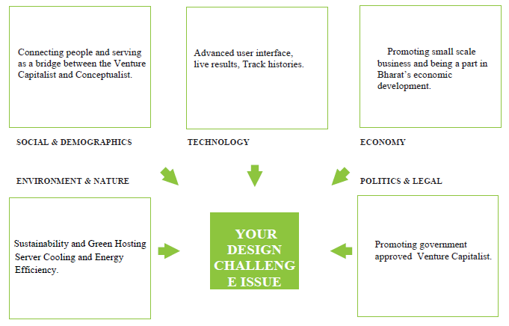
Steep Analysis

Slide 7
Existing System
Government MSME website which allows small scale business startups to register and get to know about the schemes available for them.
Live online meet Scheduling done in Google meet.
Websites used for collecting ideas from people so that everyone can view it.
Connecting people using requests and prompts which is used in all social media’s.

Slide 8
Proposed System
Allowing the users to access the websites of venture capitalist which would be available in the website
Connecting to one conceptualist is enough to view and invest on all the projects that are posted by them in the website
Once the conceptualist and Venture capitalist is connected they are able to use common webpage where they can schedule meets and view details of insurance providers

Slide 9
Modules
Dashboard
Specific dashboards are allotted for both conceptualist and ventures so they can view projects and investors details
Register and login
Ventures, Conceptualist and Startups can register in the website
Request module
Conceptualist and ventures can request each other for connection once both of them accept each other they would be redirected to a common page
Msme redirect
They can officially register themselves as startups using the MSME government website and use available schemes
Meeting dashboard
The common dashboard allows both of them to schedule meetings and view project updates

Slide 10
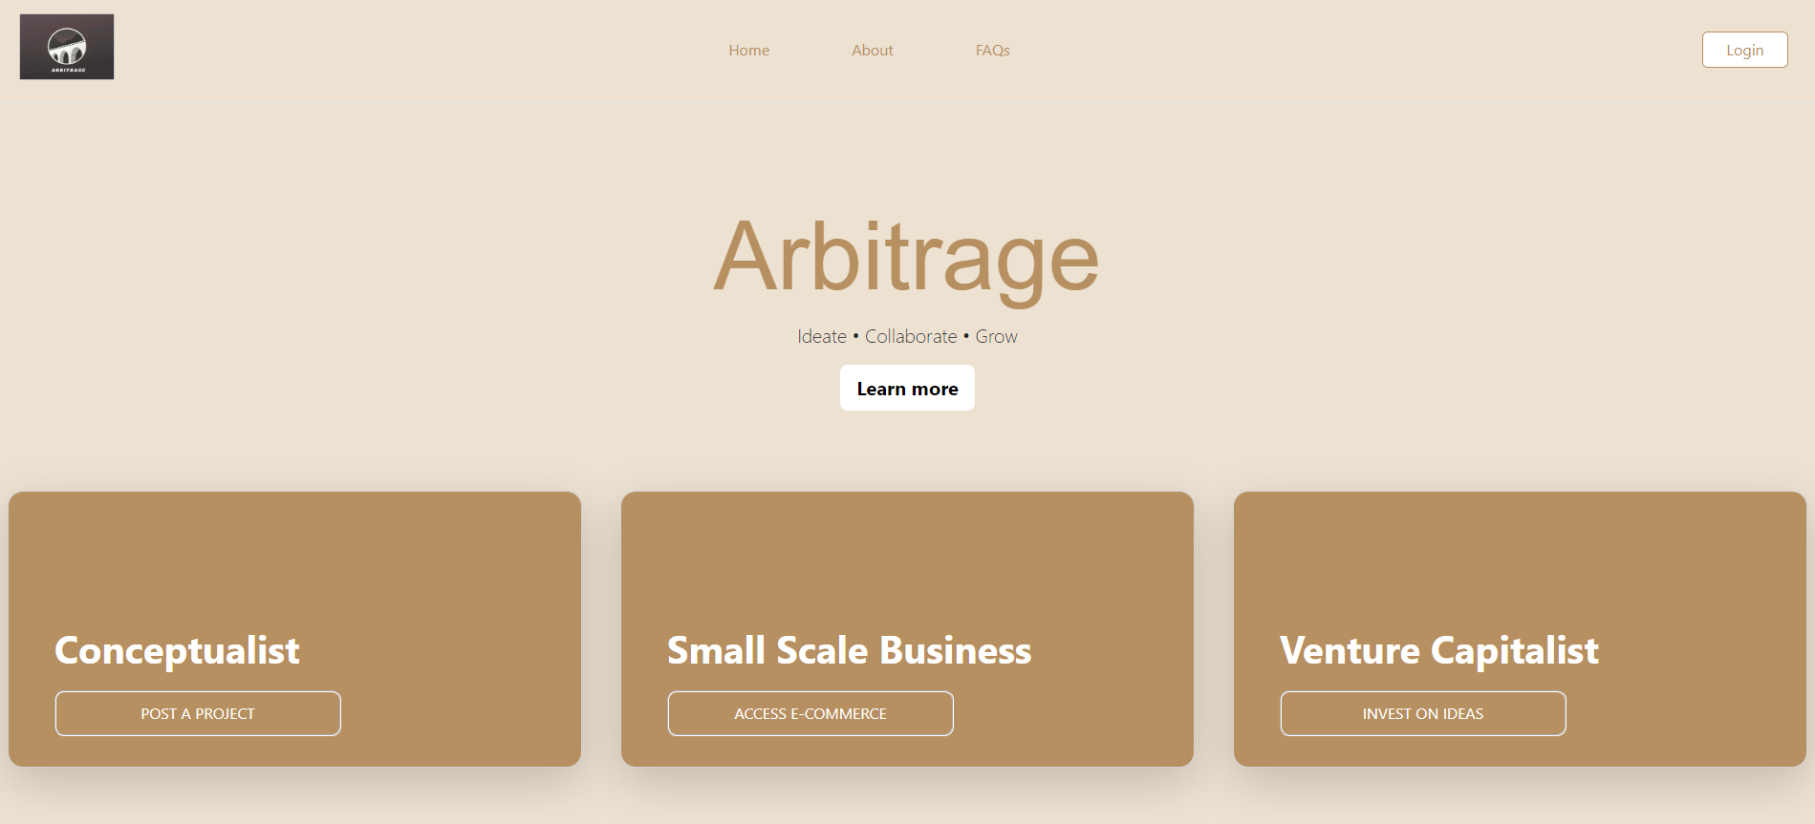
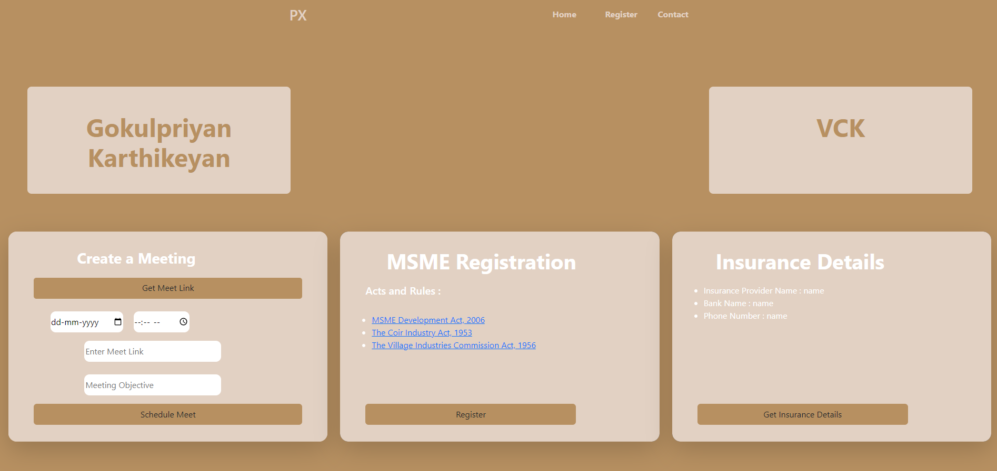
IMPLEMENTATION

Slide 11
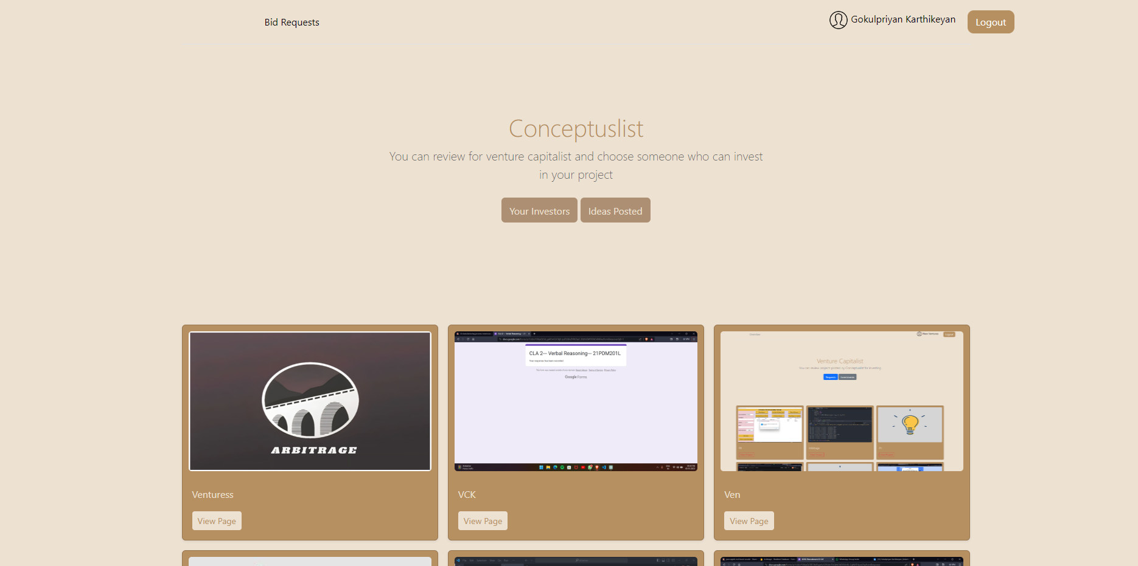
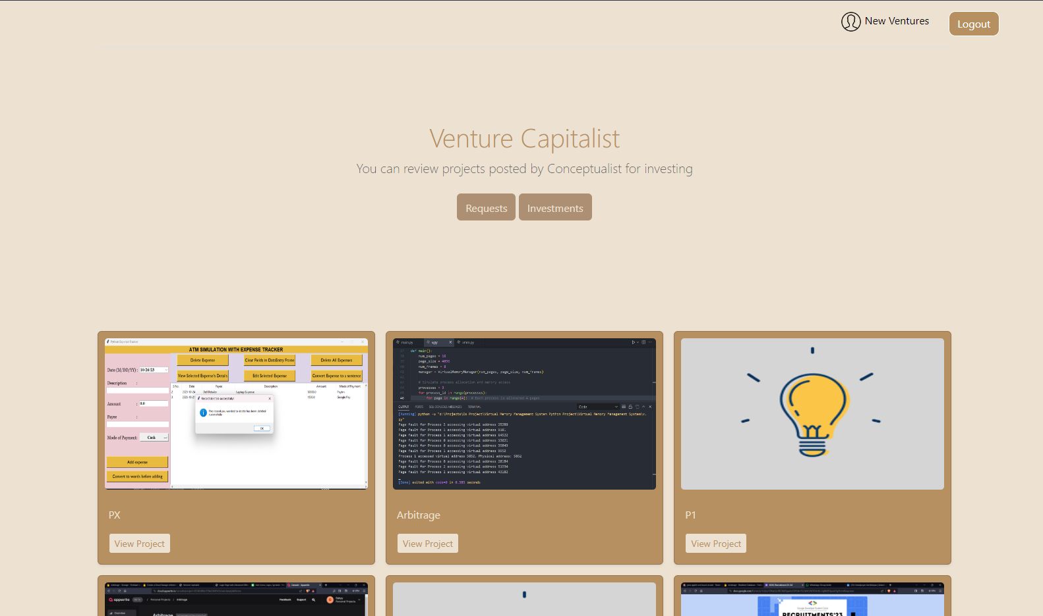
IMPLEMENTATION

Slide 12
Requirements
Software Requirements :
1. Any Browser Engine for access.
2. Internet Connection
3. Pdf reader
4. jpg or png image reader
Hardware Requirements :
1. 32bit or 64bit Processor
2. Disk space for data storage

Slide 13
REFERENCES
WEBSITES
https://www.linkedin.com/ - This website connects people with companies and industries
ARTICLES
“Why a Failed Startup Might Be Good for Your Career After All”
by Sean Silverthorne | 03 OCT 2022
(This article gives a clear idea on necessity of investments for an idea)
CONCEPTS
Concepts of feed and request are incorporated from social media’s and meta platforms.

Slide 14
Thank you
Gokulpriyan K (RA2211003020327)
Dharani P (RA2211003020340)
Evanka Vinoliya E (RA2211003020342)
Abishek U (RA2211003020334)
Vidhya V (RA2211003020335)
Kishore P (RA2211003020344)

